Slide 1


Hackathon on data science for STI policy
A STIP Data Lab and OECD-TIP event
Kick-off event
23-24 May 2020
The STIP Data Lab (and more broadly STIP Compass) has benefited from H2020 grant 101018243

Slide 2
Agenda
Welcome and structure of the hackathon (15')
Presentation of the datasets (15')
Round table introduction of the teams (one speaker per team, 1-2' per team) and team leaders
Introduction and discussion of the policy questions (40’)
Logistical issues and next steps (5')
Other questions and answers (5')

Slide 3
Welcome and structure of the hackathon

Slide 4
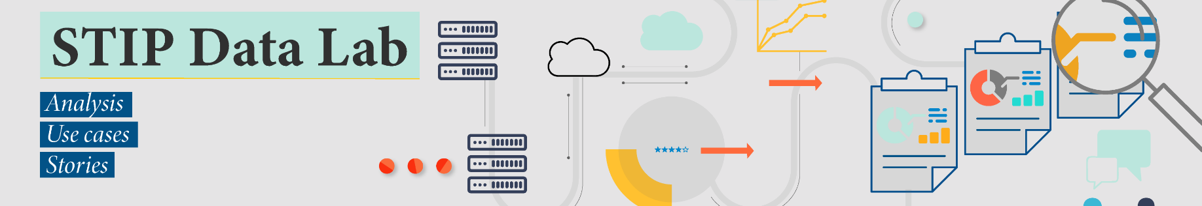
Launched in 2020 to undertake and support various types of analysis of the STIP Compass policy database, including close to 7000 policy initiatives from 57 countries and the European Union (more on this dataset later).
It aims to build a community of “lead users” of the database, involving policy makers, analysts and academics in these analyses.
To do so, it brings forth a new suite of tools and case studies aiming to help leverage the data gathered by STIP Compass.
It also builds new partnerships
With specific “volunteer” countries to produce on-demand analyses.
With the broader STI policy community through OECD internships, joint studies and hackathons.

Slide 5

Working Party on Innovation and Technology Policy (TIP)
TIP provides advice to OECD member countries to improve STI policy-making since 1993
TIP is a forum for member countries to exchange information and best practices in the field of STI policy
TIP is also involved in country-specific activities such as reviews of national STI systems
2021-22 project “Collaborative transitions” explores the role of STI policy in transitions with a focus on the role of co-creation.
Key questions
What transition goals and STI policies are countries setting in response to the COVID-19 shock?
What is essential to boost collaborative research and innovation in times of crisis and beyond?
How can alternative approaches, and tools be used effectively by policy?

Slide 6
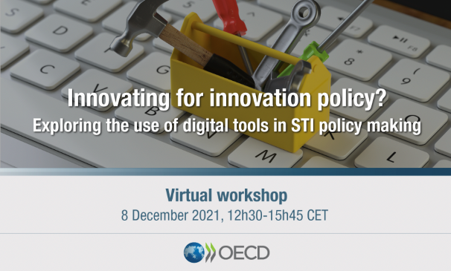

Semantic Analysis & the TIP
TIP@50 (2018)
Demonstration of semantic analysis
Collaborative Transitions Project (2021-22)
Application of semantic analysis & exploration of tools and approaches for STI policy
Semantic Analysis Guidelines Group
Build on the TIP’s progress to promote meaningful and efficient application of semantic analysis tools for STI policy analysis.

Slide 7
Structure of the hackathon
Today’s kick-off: each team will receive and discuss a policy question from a policymaker or policy analyst to tackle during the hackathon.
Next two weeks: allow at least two full days (equivalent) of work time, ideally scheduling two sprint meetings with your team leader.
Closure event (7 June, 3:00pm-5:00pm CEST): Presentation and discussion of results.
In addition, we will be organising a separate debriefing seminar where participating teams will be able to elaborate and exchange on their technical choices and experiences working during the hackathon.

Slide 8
Presentations of the datasets

Slide 9
Datasets made available for this hackathon
Use at least one of these two:
TIP STI strategies database, a text corpus including 314 STI policy strategy documents (several million words overall) from across 24 OECD countries.
STIP Compass policy database (ed. 2021), made up of close to 7000 initiatives from 57 countries and addresses all main areas of STI policy.
Optionally (and where useful), a third data source can be used:
The STI.Scoreboard dataset, containing over 400 unique STI indicators, drawing on the very latest, quality assured statistics from OECD and partner organisations.

Slide 10
TIP database of STI policy strategies Data collection
1
Strategy documents were found through desk research and classified as “intra-COVID-19” or “pre-COVID-19” based on their date of publication
2
National delegations were consulted to review the periodization of documents and provide corrections as well as additional documents to ensure representativeness
January 2020
Present
Strategy classified as intra-COVID-19
Strategy classified as pre-COVID-19

Slide 11
TIP database of STI policy strategies Coverage and document types
314 documents
from 24 countries
A
National STI strategies
B
Other national strategies implicating STI
C
STI ministry and agency strategies
D
Key pieces of legislation

Slide 12
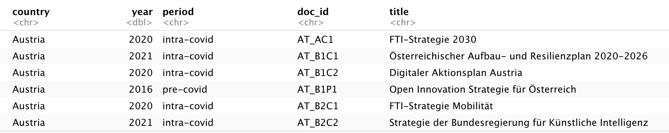
TIP database of STI policy strategies Metadata variables
Country name
Publication period
Original document title
Year of publication
Document ID
First letter after _ denotes the document type
Second letter after _ denotes publication period

Slide 13
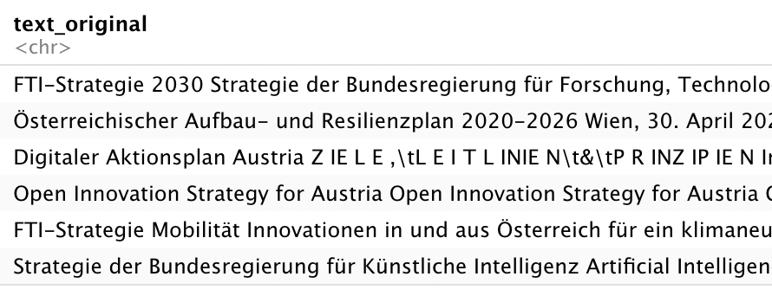
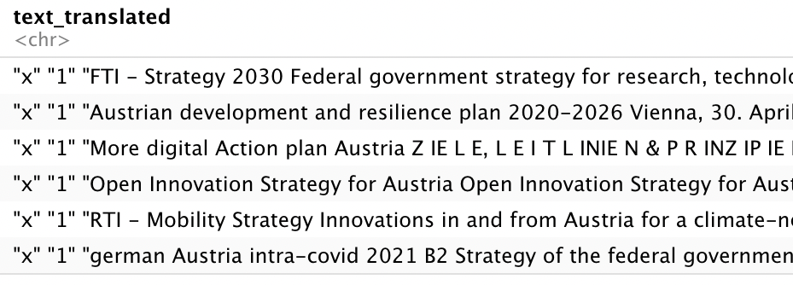
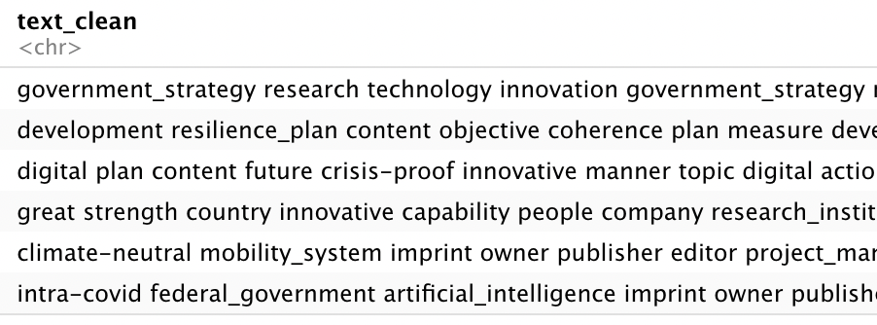
TIP database of STI policy strategies Text variables
Original text of the STI policy strategy document
Google translated text of the document
Cleaned text of the document
(punctuation, numbers, symbols removed; lemmatization; no stopwords; n-grams)

Slide 14
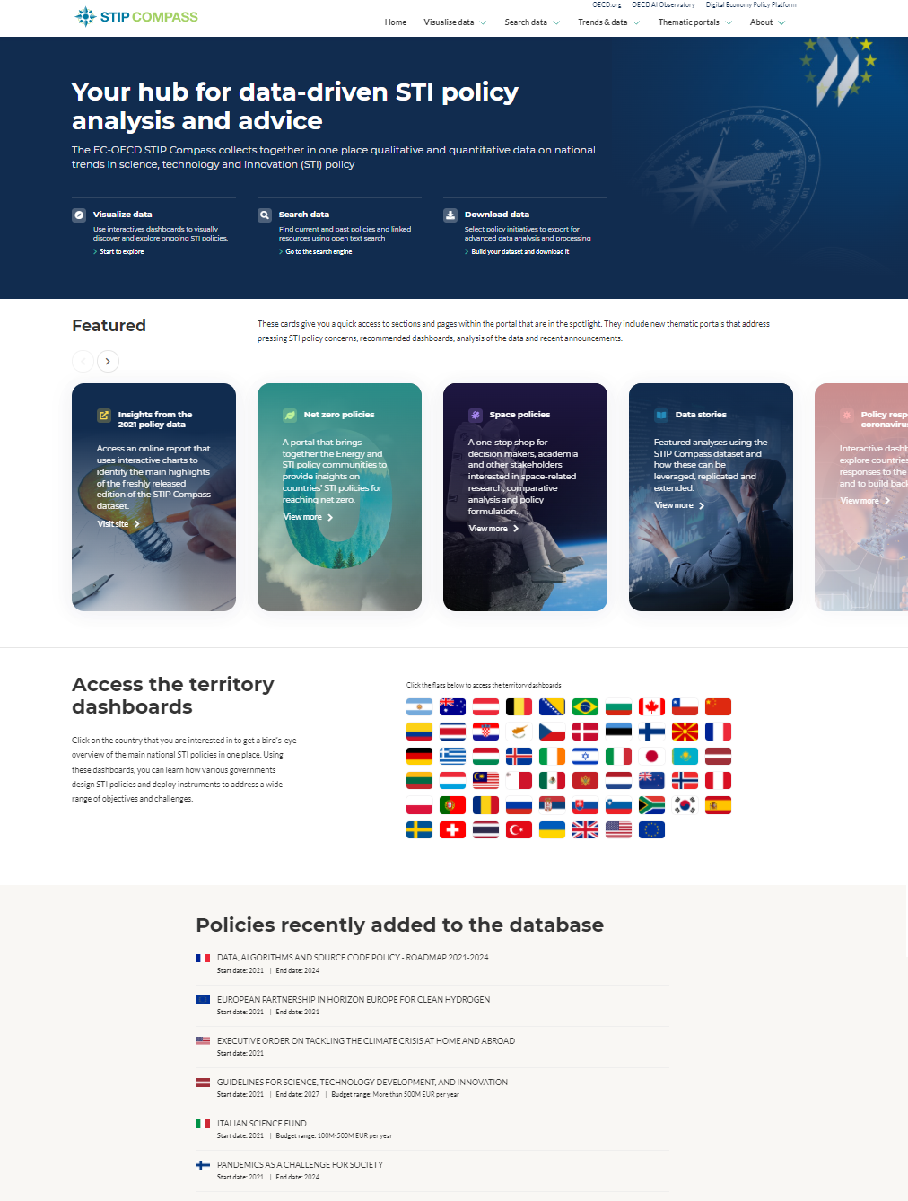

An EC-OECD joint initiative to collect together in one place qualitative and quantitative data on national trends in STI policy.
It uses a semantic database for storing, accessing and linking various kinds of data (policies, statistics, publication metadata, twitter feeds…).
It is publicly available online at stip.oecd.org.

Slide 15
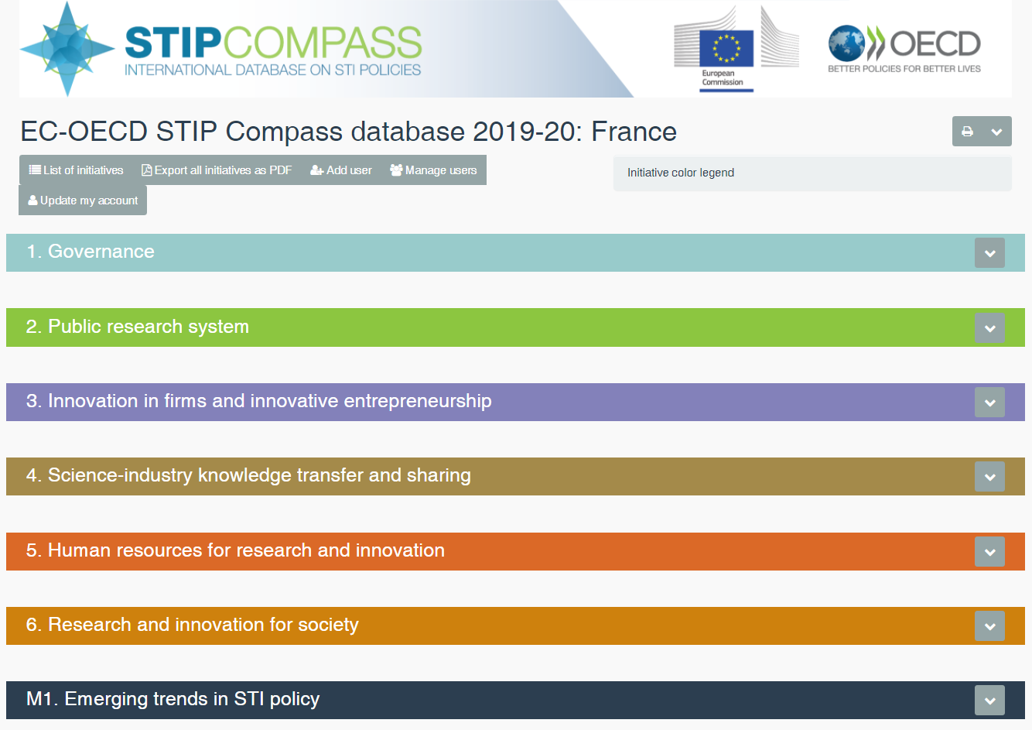
The EC-OECD STIP Survey
The main data source for STIP Compass.
Data collection is firmly structured by taxonomies to characterise policy initiatives, making responses more comparable and facilitating analysis.
Conducted every two years, it aims to collect data on national STI policy initiatives.
The survey is distributed across ministries and funding agencies by national contact points, designated mainly by delegates of our Committee for Scientific and Technological Policy (CSTP).
The survey is run for 3 months. Thereafter, it is re-opened as a monitoring tool that countries can continue to use to keep the data up-to-date.

Slide 16
“Policy initiative” as the unit of reporting
Defined as a public action that:
aims to achieve one or several public policy goals
is expected to modify or frame the behaviours of actors and stakeholders
is implemented with a minimum time horizon or on a continuous basis (i.e. not as a one-off “event”).
Characterised by taxonomies
Basic fields for textual data (name, short description, objectives, background)
A policy instrument taxonomy built based on Lit. review and OECD workshops
A taxonomy for target groups and list of budget ranges
An STI thematic taxonomy that structures the questions of the STIP Survey

Slide 17
Policy instruments taxonomy v2021
Governance
 | Strategies, agendas and plans
 | Creation or reform of governance structure or public body
 | Policy intelligence (e.g. evaluations, benchmarks and forecasts)
 | Formal consultation of stakeholders or experts
 | Horizontal STI coordination bodies
 | Regulatory oversight and ethical advice bodies
 | Standards and certification for technology development and adoption
 | Public awareness campaigns and other outreach activities
Direct financial support
 | Institutional funding for public research
 | Project grants for public research
 | Grants for business R&D and innovation
 | Centres of excellence grants
 | Procurement programmes for R&D and innovation
 | Fellowships and postgraduate loans and scholarships
 | Loans and credits for innovation in firms
 | Equity financing
 | Innovation vouchers
Indirect financial support
 | Tax or social contributions relief for R&D and innovation
 | Tax relief for individuals supporting R&D and innovation
 | Debt guarantees and risk sharing schemes
Collaborative infrastructures (soft and physical)
 | Networking and collaborative platforms
 | Dedicated support to research infrastructures
 | Information services and access to datasets
Guidance, regulation and incentives
 | Technology extension and business advisory services
 | Science and technology regulation
 | Labour mobility regulation and incentives
 | Intellectual property regulation and incentives
 | Science and innovation challenges, prizes and awards

Slide 18
Science and technology regulation instrument
Facet | Facet choices
Objective | Market regulation (e.g. antitrust law)
 | Enable technology/innovation (e.g. interoperability standards)
 | Risk mitigation (e.g. consumer and social protection)
 | Regulate the delivery of public services (e.g. requirements in procurement, education)
 | Promote research integrity
 | Protect public values
Challenge(s) addressed | Risks to human safety
 | Environmental sustainability
 | Privacy protection
 | Social disruption (e.g. job insecurity)
 | Unethical practices (e.g. discrimination)
 | Security (e.g. dual-use technologies)
 | Limited competition (e.g. monopolies, oligopolies)
 | Other
Type(s) of regulation | Formal law or regulation
 | International agreement
 | Self-regulation (e.g. codes of conduct, scientific advice, standards)
 | Regulatory experiments (e.g. sandboxes)
 | Other
Regulatory approach | Technology-based regulation (e.g. moratoria, standards of use)
 | Performance or output-based regulation (e.g. safety thresholds)
Level of governance | Local
 | Regional
 | National
 | International
Approach to monitor compliance | The regulator develops and maintains technologies for data collection, transmission and/or analytics
 | Regulated parties are incentivised to adopt monitoring technology that is not managed by the regulator
 | Regulated parties are simply required to share compliance data (no regulator support)

Slide 19
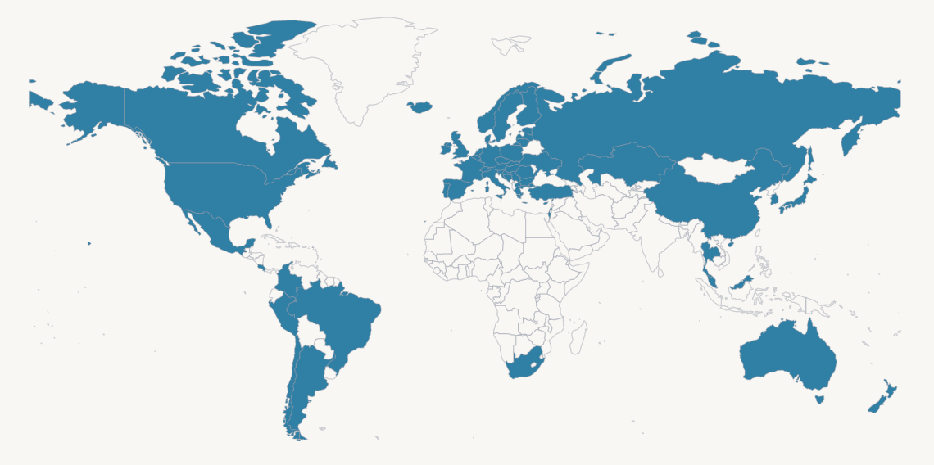
+6600 policy initiatives and +9100 policy instruments collected from 57 countries + EU in the 2021 survey (published in Nov)
Taken together, the countries covered in the STIP survey/STIP Compass database
account for an estimated 97% of global R&D

Slide 20
2021 STIP survey data
STIP Compass database indicators
 | 2021 edition | Δ2021-19
Number of users in the online questionnaire tool | 1600† | +33%
Number of organisations managing policy initiatives | 2100 | +11%
Number of policy initiatives | 6700 | +18%
Updated initiatives (prefilled from prior edition) | 3700
New initiatives (created in this edition | 2100
Number of policy instruments | 9100 | +18%
Country coverage | 57 + EU | -8%
Median number of policy initiatives by country | 96 | +13%
Share of policy initiatives including budget data | 77% | +6 p.p.
Notes:
Here we have a number of database indicators, comparing the 2021 survey with prior editions.
The burden on countries has been kept at bay. Allowing the countries to focus on 1/ adding new initiative and 2/ focus on improving quality.

Slide 21
2021 STIP survey data
STIP Compass database indicators
 | 2021 edition | Δ2021-19
Number of users in the online questionnaire tool | 1600† | +33%
Number of organisations managing policy initiatives | 2100 | +11%
Number of policy initiatives | 6700 | +18%
Updated initiatives (prefilled from prior edition) | 3700
New initiatives (created in this edition | 2100
Number of policy instruments | 9100 | +18%
Country coverage | 57 + EU | -8%
Median number of policy initiatives by country | 96 | +13%
Share of policy initiatives including budget data | 77% | +6 p.p.
25 OECD countries reported more than 100 policies
6 OECD countries reported less than 70 policies
Notes:
The level of reporting still varies by country, though in this edition it has overall increased.

Slide 22
Dataset limitations To be accounted for when analysing the data
The data consists of self-reported descriptions of national STI policies given by ministries, funding agencies and other public bodies that manage these initiatives.
Policy initiatives vary in scope and scale, which can make aggregating them in groups problematic.
What meaning should be given to the fact that one country uses twice as many policy initiatives than another to address the same policy theme?
Countries also vary in the scope and scale of their reporting.
The dataset is useful to learn about existing types of STI policies in a wide variety of topics, but it is not representative of the actual population of policies in countries.

Slide 23
Weighting policy initiatives by budget
One way to scale policies is using the budget range as a weight.
Budget range (in Million Euros) | Budget weight coefficient
Don’t know / Not applicable | 0 (no weight)
Less than 1 M | 0.005
1 M – 5 M | 0.01
5 M – 20 M | 0.05
20 M – 50 M | 0.2
50 M – 100 M | 0.5
100 M – 500 M | 1
More than 500 M | 5

Slide 24
The STI.Scoreboard platform
Provides policy makers, analysts and the public at large with a resource to retrieve STI statistical indicators across OECD countries and several other economies.
It contains over 400 unique indicators on a wide range of topics such as research and development, science, business innovation, patents, education and the economy.
It draws on the very latest, quality assured statistics from OECD and partner international organisations.
Accessible through a dedicated API using SDMX queries.

Slide 25
Accessing the hackathon’s datasets
Quick access instructions are given in the main page of the hackathon’s GitHub repository (link below). It provides the necessary guidance, codebooks, Python/R code snippets and examples.
We will be sharing this link in the chat.
https://github.com/STIPlab/hackathon

Slide 26
Round table introductions
of teams and team leaders

Slide 27
Kick-off day 1
Team | Team leader | TL email
Aalborg University | Tiago Santos Pereira | tsp@ces.uc.pt
Georgia Institute of Technology | Caroline Paunov | Caroline.PAUNOV@oecd.org
Korea Advanced Institute of Science and Technology | Alan Paic | Alan.paic@oecd.org
University of Turin | Laura Kreiling | Laura.KREILING@oecd.org

Slide 28
Kick-off day 2
Team | Team leader | TL organisation | TL email
Fraunhofer Institute | Joseba Sanmartín | Spanish Foundation for Science and Technology (FECYT) | Joseba.Sanmartin@fecyt.es
SPRU, University of Sussex Business School | Daniel Ferreira | Portuguese national funding agency for science, research and technology (FCT) | Daniel.Ferreira@fct.pt
University of Tokyo | Philippe Larrue | OECD | Philippe.LARRUE@oecd.org

Slide 29
Introduction and discussion of the policy questions

Slide 30
Aalborg University – Tiago Santos Pereira REVISED
To what extent can we identify distinct instruments and country policy goals that reflect a novel co-creation approach vs. a more traditional knowledge-transfer approach?
You could use keywords to delineate a 'novel co-creation' approach from a 'traditional knowledge transfer' approach, e.g.
Co-creation: ‘joint’, longer time period (e.g. institutional), involvement of different actors (e.g. including civil society)
Knowledge transfer: based on contracts, short-term, university-industry based
STIP Compass has a thematic portal dedicated to this topic, which offers further insights on these definitions: https://stip.oecd.org/knowledge-transfer/
Analysis could be extended to the Covid Watch policy data to explore whether the Covid-19 response initiatives are particularly characteristic of a co-creation approach?

Slide 31
Aalborg University: Possible dataset slices
TIP Strategies
Example keywords: knowledge_transfer, co-creation, commercialisation, technology_transfer, clusters, intellectual_property
STIP Compass:
Collaborative research and innovation (TH42, 537 policies); Commercialisation of public research (TH, 314 policies); Cluster policies (TH47, 278 policies); Intellectual property rights in public research (TH46, 163 policies); Intersectoral mobility (TH44, 113 policies); Transfer and linkage strategies (TH41, 183 policies)
STI.Scoreboard:
HERD/GOVERD financed by firms; innovative firms cooperating with HEIs and PRIs; ...

Slide 32
Georgia Tech – Caroline Paunov
To what extent are countries’ green transition goals, as set out in their strategies, reflected in their STI policies?

Slide 33
Georgia Tech: Possible dataset slices
TIP Strategies
Example keywords: energy_transition; renewable_energy; hydrogen; battery_production; mobility_transition; …
STIP Compass:
Green energy transitions (TH92, 249 policy initiatives); Stimulus for STI systems (TH96, 212 policies); Building more resilient societies and economies (TH98, 73 policies); Research and innovation for society strategy (TH58, 282 policies)
STI.Scoreboard:
Government support by SDG: Planet and Infrastructure; Health and Medical Sciences; Industry and Knowledge; Security

Slide 34
KAIST – Alan Paic
Can we characterise typologies of policies in support of making research data from publicly funded research openly accessible and reusable to the largest extent possible?
In particular, policies that:
Foster and support open access by default to research data and other research-relevant digital objects from public funding (read more);
Develop infrastructure and services to facilitate the accessibility of research data and other research-relevant digital objects from public funding within and across scientific domains and disciplines.

Slide 35
KAIST: Possible dataset slices
TIP Strategies
Example keywords: open_data; data_access; open_access; research_data; research_infrastructure; transparency; …
STIP Compass:
Open science and enhanced access to publications and research data (TH10, 328 policies); Information services and access to datasets (PI023, 398 policies); Open science measures in response to Covid-19 (THc41-44, 108 policies - available separately here)

Slide 36
University of Turin – Laura Kreiling
Can we characterise typologies of strategies and/or policies that aim to foster the responsible development of emerging technologies for societal benefit? Do such policies focus on specific technologies and, if so, which ones?
responsible development of technologies
…aims to better align both the innovation process and its outcomes with the values, needs and expectations of society
…means taking into account effects and potential impacts on the environment and society
what are emerging technologies?
referred to as: “key”, “emerging”, “converging” or “critical” technologies
largely unrealized or ongoing: development and/or application
characteristics: radical novelty, potential to change the status quo, uncertainty, ambiguous
examples: nanotechnology, robotics, synthetic biology, AI, quantum computing

Slide 37
University of Turin: Possible dataset slices
TIP Strategies
Example keywords: technological_change; impact_assessment; societal_change; data_regulation; artificial_intelligence; social_impact; responsible_development …
STIP Compass:
Ethics of emerging technologies (TH89, 239 policies); Science and technology regulation (PI032, 156 policies); Regulatory oversight and ethical advice bodies (PI033, 142 policies); Research and innovation for society strategy (TH58, 282 policies)

Slide 38
Fraunhofer Institute – Joseba Santamarín
In what ways do STI strategies differ between countries and particularly around the themes of sustainability, resilience, inclusivity, competitiveness, and digitalisation?
This question may be placed at the formulation stage of the policy cycle, when policy makers need to explore different courses of action and investigate alternative paths.
Suggestion from the OECD hackathon team: The team / TL could choose to focus on narrower areas.

Slide 39
Fraunhofer Institute: Possible dataset slices
TIP Strategies
Example keywords: sustainability; resilience; inclusivity; competitiveness; digitalization; national_objectives; transition; policy_strategy; …
STIP Compass:
Strategies, agendas and plans (PI024, 1341 policies); Policy intelligence (PI031, 411 policies); Formal consultation of stakeholders or experts (PI025, 234 policies); STI plan or strategy (TH13, 400 policies); Research and innovation for society strategy (TH58, 282 policies); Business innovation policy strategies (TH30, 301 policies)
STI.Scoreboard:
A number of indicators on R&D budgets for SDG and PCT/IP5 environmental patents; a wide range of business innovation indicators (e.g. BERD, BERD in ICT services), ...

Slide 40
SPRU – Daniel Ferreira
To what extent is it possible to characterise typologies of policy proposals on the theme of scientific employment and research careers?
Possibly considering,
The policy objectives expressed in the databases:
training of researchers; researchers' labour market; scientific employment; job mobility; research careers; evaluation of researchers, etc.
The diversity of socio-economic contexts involved:
geopolitical variables; economic structure; socio-demographic profile; data on education and qualification, institutional context, etc.
The diversity and specificity of each STI system:
HR in Science and Technology activities; public and private investment in R&D; innovative profile of the country/region; digitalization indicators; Technological Balance of Payments, etc.

Slide 41
SPRU: Possible dataset slices
TIP Strategies
Example keywords: research_career; higher_education; science; employment; university_employees; …
STIP Compass:
STI human resource strategies (TH50, 240 policies); Research careers (TH53, 285 policies); Inter-sectoral mobility (TH44, 113 policies); Doctoral and post-doctoral research (TH52, 296 policies); International mobility of human resources (TH55, 313 policies); Gender balance and inclusiveness (TH54, 238 policies); Postdocs and other early-career researchers (TG11, 1556 policies); PhD students (TG12, 1207 policies); Established researchers (TG9, 1926 policies)
STI.Scoreboard:
Share of adult population with a doctorate; Total researchers (in FTE) per thousand total employment; Various indicators on women participation in STI activities; (e.g. Percentage of women among researchers); International mobility of scientific authors (outflows, inflows, stayers); among others.

Slide 42
University of Tokyo – Philippe Larrue
What information is provided in strategies about policy implementation, such as specific goals, timelines, budgetary commitments or policy actions and/or their governance/monitoring?

Slide 43
University of Tokyo: Possible dataset slices
TIP Strategies
Example keywords: timeline, milestone, action_plan, budget_allocation, progress_evaluation, monitoring, ...
STIP Compass:
Strategies, agendas and plans (PI024, 1341 policies) which can be decomposed by themes, e.g.: STI Plan or strategy (TH13, 344 strategies) ;Public research strategies (TH18, 257 strategies); Business innovation policy strategies (TH30, 227 strategies); Transfer and linkages strategies (TH41, 102 strategies); STI human resource strategies (TH50, 148 strategies); Research and innovation for society strategy (TH58, 192 strategies).

Slide 44
Logistical issues and next steps

Slide 45
Logistical issues and next steps
Teams may now contact their team leaders via email to further clarify the policy question, if needed.
During the next couple of weeks, you should arrange two 30-45’ sprint meetings with your team leader to discuss progress and receive feedback.
For the closure event on 7 June, you should prepare a 10’ presentation that will be followed by a 5’ Q&A. You will soon receive a calendar invitation.
The OECD hackathon team will be able to answer any questions via GitHub. Today’s slides can also be found there.
https://github.com/STIPlab/hackathon

Slide 46
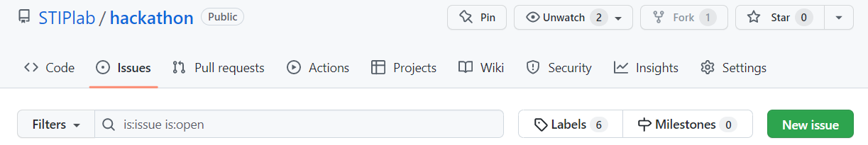
How to ask your questions via GitHub to the OECD hackathon team
You will need a GitHub account.
Go to the repository’s “Issues” tab and create a new issue:
You’ll need to tag the issue using the following pre-defined labels so that the right persons in the organising team are notified: Logistics, TIP strategies dataset, STIP Compass dataset, STI.Scoreboard dataset, Other.
If you don’t use any of these labels, we won’t be notified of your question.

Slide 47
Other Q&A

Slide 48
Hackathon on data science for STI policy
A STIP Data Lab and OECD-TIP event
Kick-off event
23-24 May 2020
The STIP Data Lab (and more broadly STIP Compass) has benefited from H2020 grant 101018243

